Slide 1
Google Data Analytics
Case Study
Cyclistic bike-share
Created by: Milan Rigo
Last Updated: 02/29/2022

Slide 2
Questions to Analyze:
How do annual members and Casual riders use Cyclistic bikes differently?
Why would Casual riders buy Cyclistic annual memberships?

Slide 3
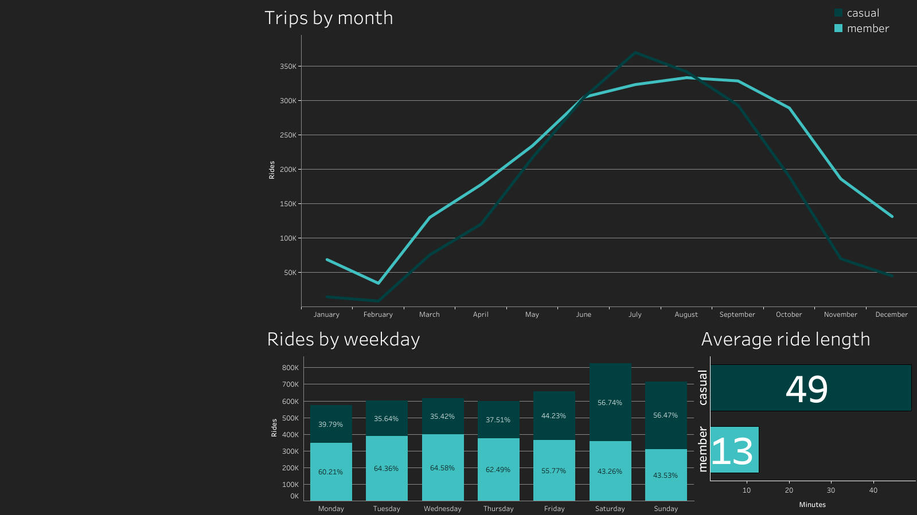
Most active months for casual riders are from June to August
Casual riders are more active on the weekend
On average casual riders take longer trips than members

Slide 4
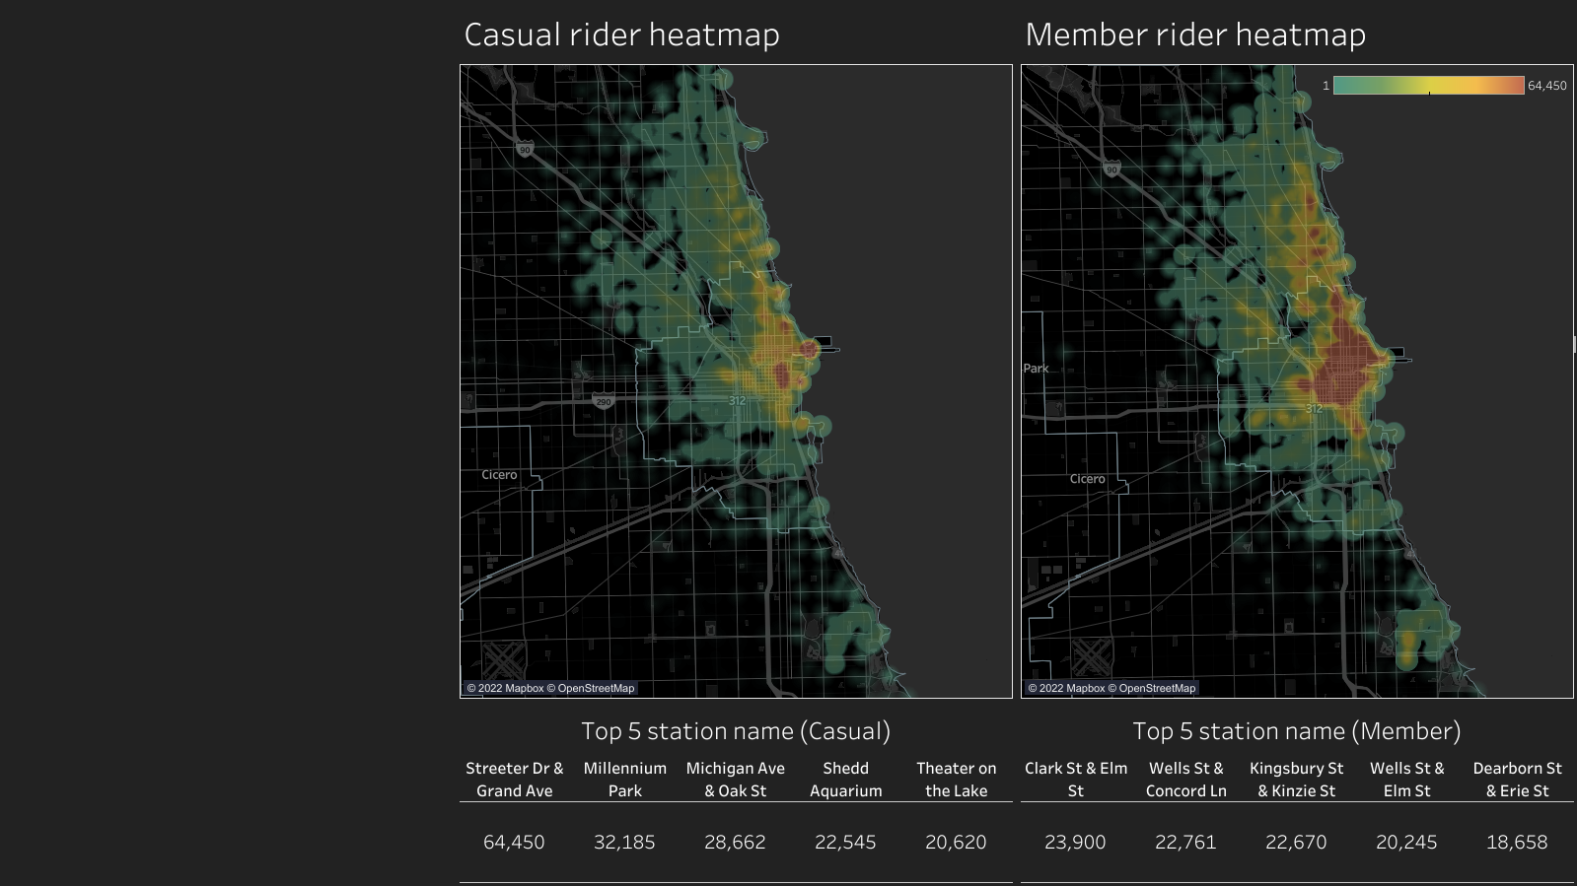
Casual riders more concentrated around the coast area
Most popular station for casual riders is: Streeter Dr & Grand Ave
Members are spread around the stations (office area)

Slide 5
Recommendations
Marketing campaign should start at spring as the number of trips start to build up.
Casual rides peak on the weekends therefore the marketing campaign could include weekend only type of membership.
New membership type where the rider benefits from the longer trips.

Slide 6
Appendix
Tableau viz
Data cleaning and manipulation using SQL
Historical trip data
Data licence

